Slide 1


Artificial Intelligence and Data Science
Data Science and Visualization
24ADI204
DATA-VIZ HACK-A-BIT (2025-2026)
Review-1 (10th March,2026)
Team Number: 02
1.________KARTHICK.N_______(24BAD055)
2.________MANOJ.M________(24BAD067)
3.________NEHA.N .K________(24BAD078)
4.________PRANESH.M_______(24BAD089)

Slide 2


Problem Statement
The US aviation network loses millions of minutes annually to flight delays, causing massive financial and operational disruptions. It is incredibly difficult to isolate whether delays are caused by compounding network domino effects (late departures), airline inefficiencies, or independent bottlenecks like weather. We need to decode these raw, highly skewed operational logs into visual narratives to identify the true root causes of delays

Slide 3

Project Objectives
Primary Objective: To uncover the root operational and seasonal drivers of flight disruptions using advanced visual storytelling and statistical analysis.
Secondary Objective: To mathematically clean, normalize, and transform a heavily right-skewed dataset of 1.7 million rows into a machine-learning-ready format.
Expected Outcome: A perfectly encoded, lightweight dataset ready for dimensionality reduction, culminating in an interactive dashboard for visualizing delay risks.

Slide 4
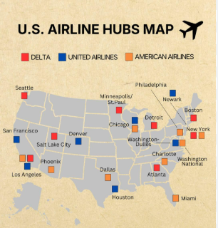
Scope of the Project
Data Footprint: Analyzing 1.7 million US domestic flight records from 2024.
Operational Focus: Evaluating the Top 10 highest-volume airlines and major US airport hubs.
Analytical Boundary: Excluding fully cancelled or diverted flights to focus purely on continuous delay minutes and network bottlenecks.

Slide 5

Dataset Description
Dataset Source: Official US Logistics & Aviation Portal (Bureau of Transportation Statistics / Department of Transportation)
Number of records: 1,669,746 rows
Number of features: 26 original raw columns (Expanded to 32 engineered features)
Target variable: ARR_DELAY (Continuous) / IS_DELAYED (Binary > 15 mins)
Data type: Structured, tabular numeric and categorical data

Slide 6

Methodology(Process / Workflow)
Data Collection: Sourced a comprehensive 2024 US flights dataset from Kaggle.
Data Preprocessing: Handled ghost rows, capped extreme outliers (1440 minutes), and imputed missing time fields using medians.
Exploratory Data Analysis (EDA): Mapped density correlations, plotted Top 10 airline operational variances, and identified independent delay triggers.
Feature Engineering (Till Week 6): Applied Cube Root transformations to fix extreme skewness, MinMax Scaling for time variables, and memory-safe Label Encoding for high-cardinality airports.

Slide 7
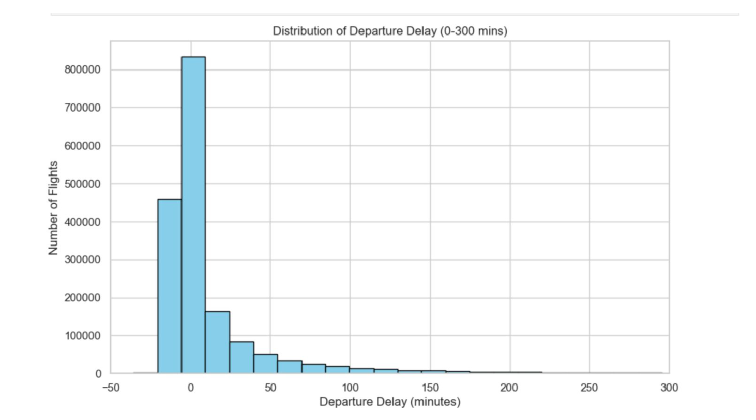
Results From Workflow
EDA INSIGHTS
The Distribution of Delays
Heavy Right Skewness: Follows a strict power-law distribution.
Operational Floor: No left tail, as flights physically cannot depart significantly early.
The Outlier Reality: Extreme delays stretch infinitely to the right, representing network failures rather than data entry errors.

Slide 8
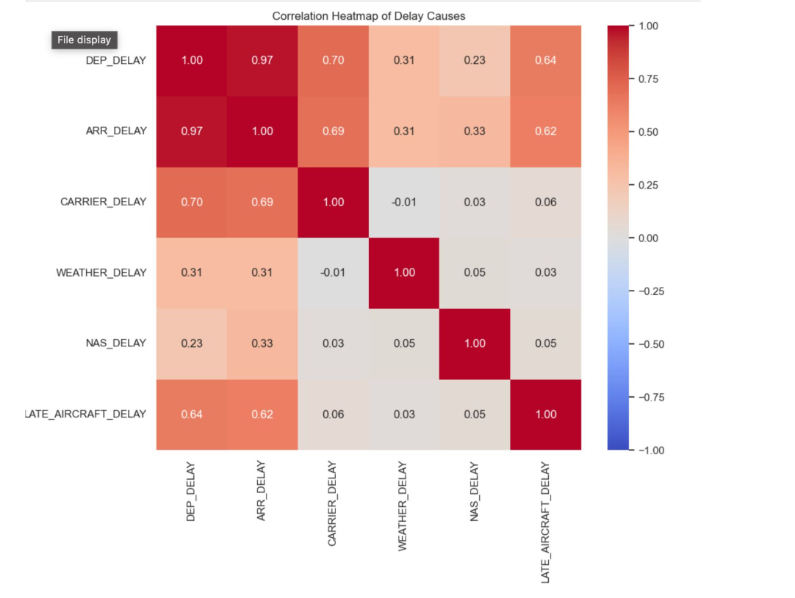
Results From Workflow
Network Bottlenecks are Independent
Target Confirmation: Departure and Arrival delays share a 0.97 linear correlation.
Isolated Root Causes: Weather, Carrier, and NAS delays show near-zero correlation with each other.
Insight: Delays are triggered by isolated systemic failures, not compounding category errors.

Slide 9
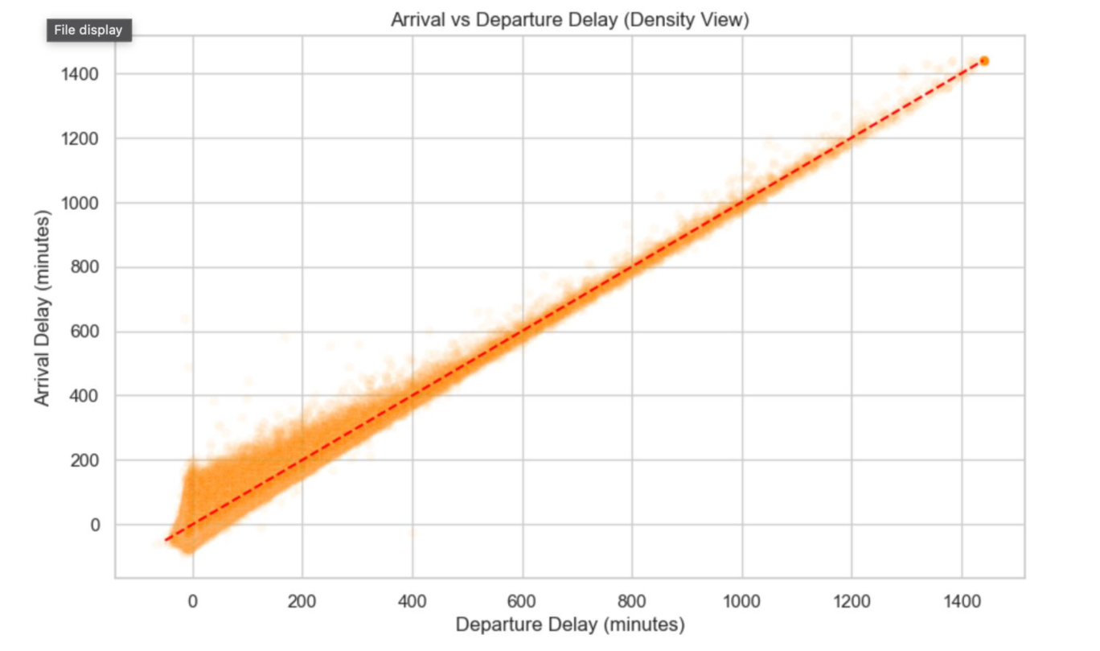
Results From Workflow
The Domino Effect & Time Recovery
Near 1:1 Correlation: Late departures almost definitively trigger late arrivals.
Density Mapping: Used alpha-blending to prevent overplotting of 1.7 million rows.
"Making Up Time": The dense cluster below the trendline proves pilots frequently recover time mid-air.

Slide 10
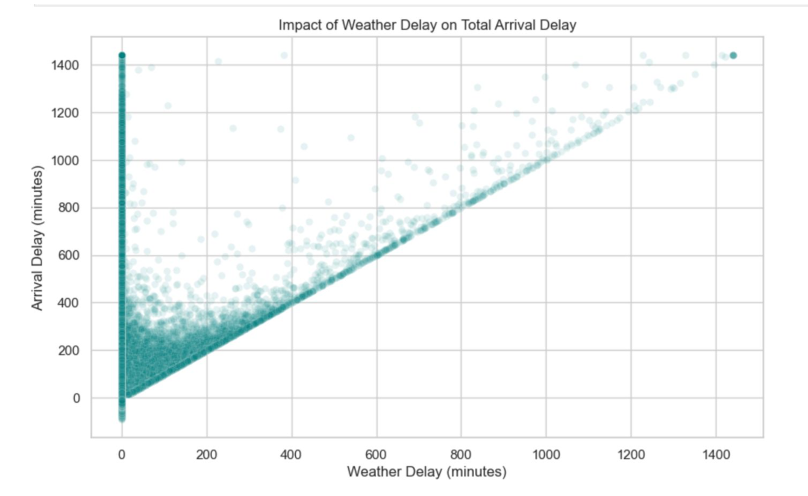
Results From Workflow
The Weather Boundary Effect
Zero-Weather Delays: The massive vertical spike at 0 indicates extreme delays caused entirely by non-weather factors.
The Hard Boundary: The sharp diagonal bottom edge shows Total Delay can never be less than the Weather Delay component.
Compounding Variables: Points floating above the diagonal indicate weather delays combined with other systemic issues.

Slide 11
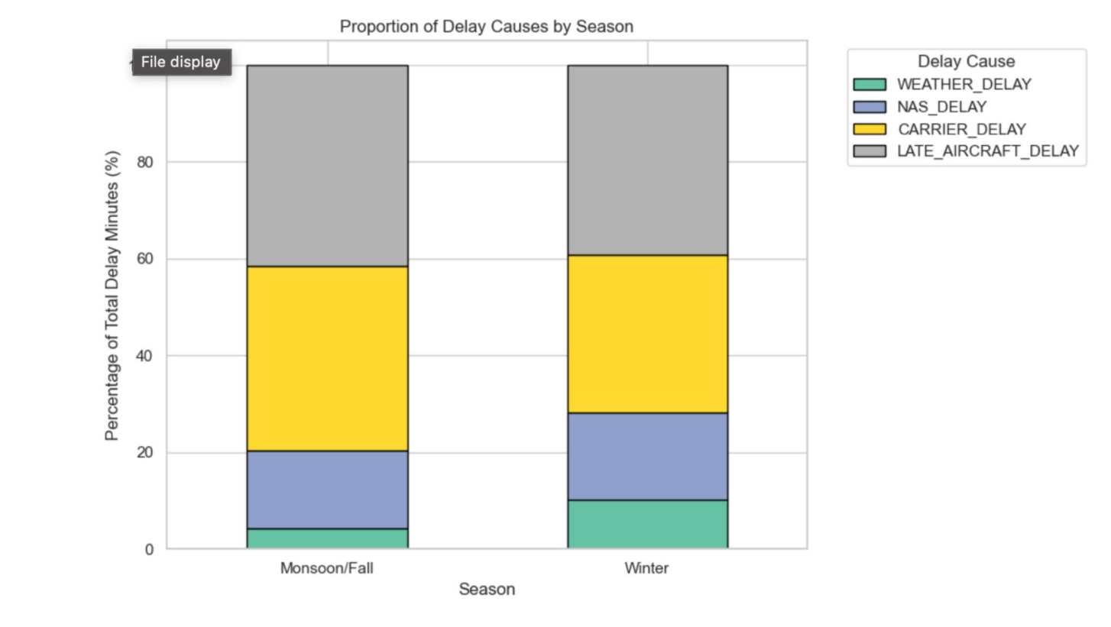
Results From Workflow
Seasonal Shifts in Delay Causes
Dynamic Proportions: Delay causes are not static; they fluctuate based on the operational season.
Winter Vulnerability: Weather (green) and NAS bottlenecks (blue) consume a visibly larger proportion of total delays in Winter.
Constant Factors: 'Late Aircraft' domino effects (gray) remain the dominant disruption regardless of the season.

Slide 12

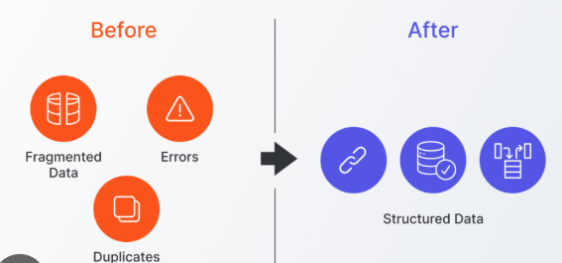
Results From Workflow
  Successfully cleaned "ghost rows" ensuring strict structural integrity across all 1.6+ million rows.
  Converted string-based time entries (e.g., '06:00') into continuous "minutes past midnight" numerical features for mathematical scaling.
  Engineered a macro-level SEASON feature to transition from granular daily data to high-level operational trends.

Slide 13
Results From Workflow
Summary statistics: Most flights arrive perfectly on time; extreme multi-hour delays are statistically rare but highly disruptive.
Distribution analysis: DEP_DELAY and ARR_DELAY follow a strict, heavy-tailed Power Law distribution.
Correlation findings: A near 1:1 direct mathematical correlation exists between Departure Delays and Arrival Delays.
Key insights: Delay causes like Weather and National Airspace System (NAS) bottlenecks act independently and do not trigger one another

Slide 14

Expected Final Results
Data quality improvements: Safely tamed massive outliers and successfully handled missing NaN values without losing valuable historical records.
Key EDA findings: Bivariate density mapping (using alpha blending) proved that while late departures usually mean late arrivals, pilots frequently "make up time" in the air
Dataset readiness status: The dataset has successfully bypassed the "Curse of Dimensionality" via smart Label Encoding, making it 100% scaled, un-skewed, and mathematically ready for Week 7.

Slide 15

Roles & Responsibilities
Team Member | Roles & Responsibilities
KARTHICK.N | Feature Engineering Pipeline, Transformation Math (Cube Root/Scaling), and Error Debugging.
MANOJ.M | Exploratory Data Analysis, Bivariate Density Plotting, and Seaborn Visualizations.
NEHA.N.K | Data Cleaning, Outlier Capping, and Missing Value Imputation.
PRANESH.M | Data Hunting, GitHub Repository Management, and Presentation Formatting.

Slide 16

Challenges Faced
Data quality issues: Time columns were improperly formatted as text strings (HH:MM), crashing standard scalers until custom conversion logic was written.
Outliers: Standard visualization plots were completely illegible due to heavy right-tailed skewness (delays up to 24 hours).
Feature selection difficulty: Trying to One-Hot Encode 300+ US airports created a 1,062-column dataset that risked crashing the system's RAM.
Overplotting: Standard scatter plots turned into solid blocks of color due to plotting 1.7 million overlapping points..

Slide 17

Future Work & Conclusion
Future Work:
Next week involves dropping redundant categorical text columns to execute Principal Component Analysis (PCA) safely. Following that, we will integrate our EDA visuals into a fully interactive Streamlit web dashboard.
Conclusion:
We have successfully transitioned our project from descriptive statistics into advanced mathematical preparation. The dataset is no longer just raw flight logs; it is a stable, scaled foundation ready for complex Unsupervised Learning algorithms.

Slide 18
References
Kaggle – Flight Delay Dataset Repository
https://www.kaggle.com/datasets/karthick564/flight-delay-analaysis-cleaned
Scikit-learn Documentation – Machine Learning & PCA Techniques
https://scikit-learn.org/stable/
Pandas Documentation – Data Cleaning and Data Manipulation
https://pandas.pydata.org/docs/
Seaborn & Matplotlib Documentation – Data Visualization Libraries
https://seaborn.pydata.org/
https://matplotlib.org/

